Slide 1

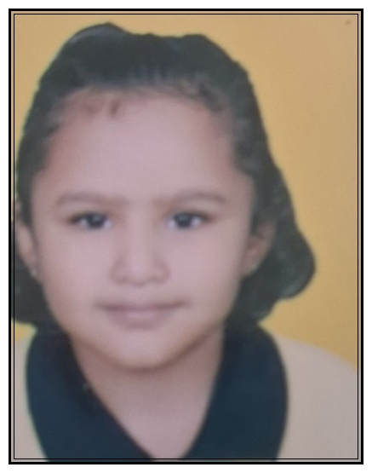
MAHESHWARI PRAGATI MANDAL
MALAD SAMITIES
MALAD UTSAV 2025
⭐⭐⭐⭐⭐
DHRUVI DHOOT
⭐⭐⭐⭐⭐
Parent Name: Kushal Dhoot
Standard: Jr KG
Grade A

Slide 2
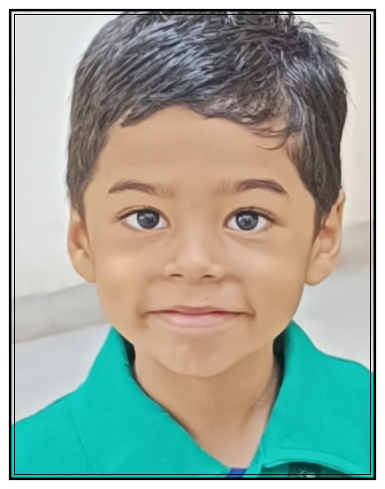
MAHESHWARI PRAGATI MANDAL
MALAD SAMITIES
MALAD UTSAV 2025
⭐⭐⭐⭐⭐
HARSHAL MAHESHWARI
⭐⭐⭐⭐⭐
Parent Name: Nikhil Maheshwari
Standard: Jr KG
Grade A

Slide 3
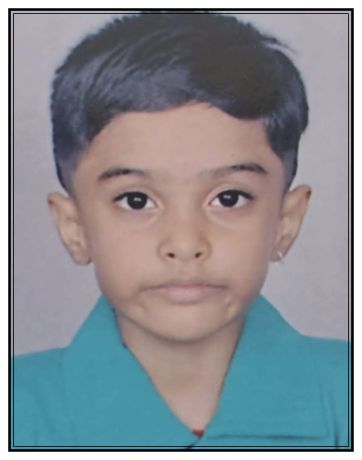
MAHESHWARI PRAGATI MANDAL
MALAD SAMITIES
MALAD UTSAV 2025
⭐⭐⭐⭐⭐
MRUNAL LADDHA
⭐⭐⭐⭐⭐
Parent Name: Rupali Pushpak Laddha
Standard: Jr KG
Grade A

Slide 4
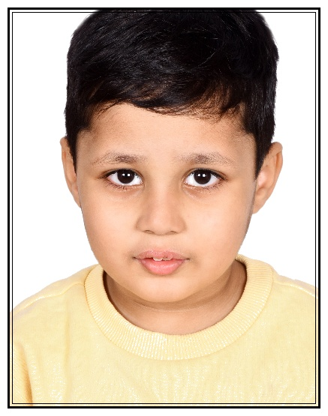
MAHESHWARI PRAGATI MANDAL
MALAD SAMITIES
MALAD UTSAV 2025
⭐⭐⭐⭐⭐
NEEV MAHESHWARI
⭐⭐⭐⭐⭐
Parent Name: Aarti Maheshwari
Standard: Jr KG
Grade A

Slide 5
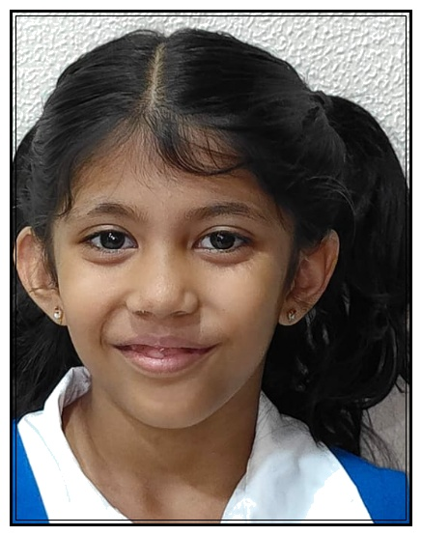
MAHESHWARI PRAGATI MANDAL
MALAD SAMITIES
MALAD UTSAV 2025
⭐⭐⭐⭐⭐
AVEESHA BHALA
⭐⭐⭐⭐⭐
Parent Name: Anuj Bhala
Standard: Sr KG
Grade A

Slide 6
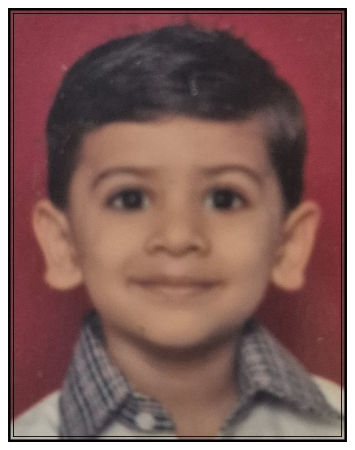
MAHESHWARI PRAGATI MANDAL
MALAD SAMITIES
MALAD UTSAV 2025
⭐⭐⭐⭐⭐
KRIYANSH MALPANI
⭐⭐⭐⭐⭐
Parent Name: Priyanka Malpani
Standard: Sr KG
Grade A

Slide 7
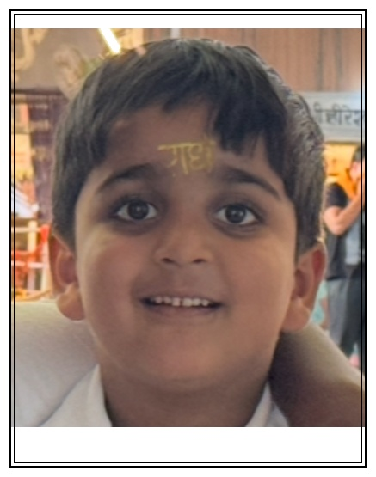
MAHESHWARI PRAGATI MANDAL
MALAD SAMITIES
MALAD UTSAV 2025
⭐⭐⭐⭐⭐
PRANAY JAJOO
⭐⭐⭐⭐⭐
Parent Name: Jyoti Jajoo
Standard: Sr KG
Grade A

Slide 8
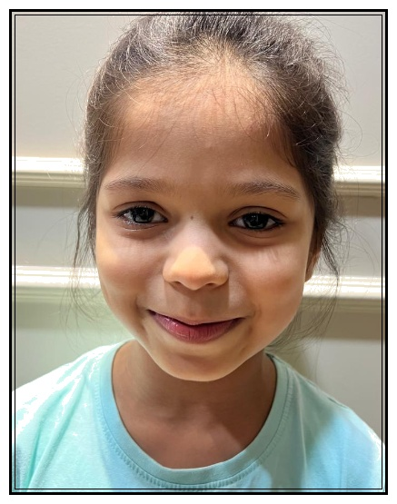
MAHESHWARI PRAGATI MANDAL
MALAD SAMITIES
MALAD UTSAV 2025
⭐⭐⭐⭐⭐
DIA RATHI
⭐⭐⭐⭐⭐
Parent Name: Abhishek Rathi
Standard: I
Grade A

Slide 9
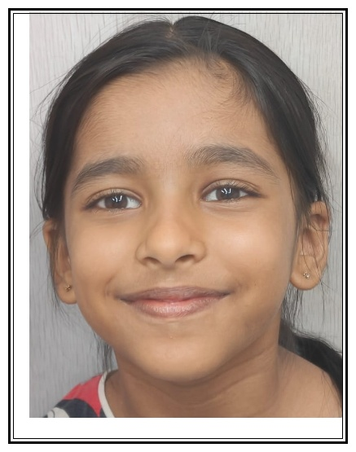
MAHESHWARI PRAGATI MANDAL
MALAD SAMITIES
MALAD UTSAV 2025
⭐⭐⭐⭐⭐
KHYATI BHAIYYA
⭐⭐⭐⭐⭐
Parent Name: Ashish Poonam Bhaiyya
Standard: I
Grade A

Slide 10
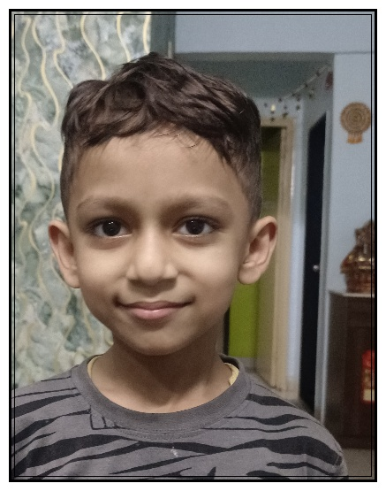
MAHESHWARI PRAGATI MANDAL
MALAD SAMITIES
MALAD UTSAV 2025
⭐⭐⭐⭐⭐
SHREYANSH DAGA
⭐⭐⭐⭐⭐
Parent Name: Aditya Daga
Standard: I
Grade A

Slide 11
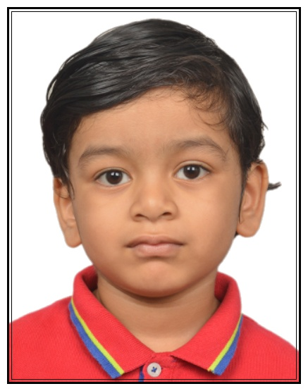
MAHESHWARI PRAGATI MANDAL
MALAD SAMITIES
MALAD UTSAV 2025
⭐⭐⭐⭐⭐
ARJUN RAHUL ASSAWA
⭐⭐⭐⭐⭐
Parent Name: Rahul & Suchika Assawa
Standard: I
Grade A*

Slide 12
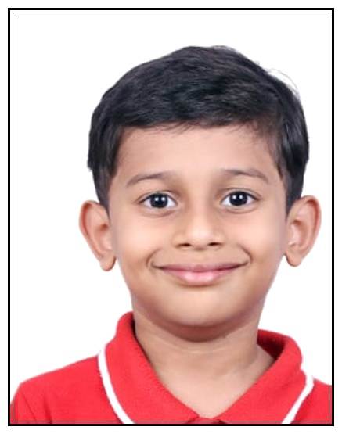
MAHESHWARI PRAGATI MANDAL
MALAD SAMITIES
MALAD UTSAV 2025
⭐⭐⭐⭐⭐
NAITIK NILESH TAWARI
⭐⭐⭐⭐⭐
Parent Name: Nilesh Tawari
Standard: I
Grade A+

Slide 13
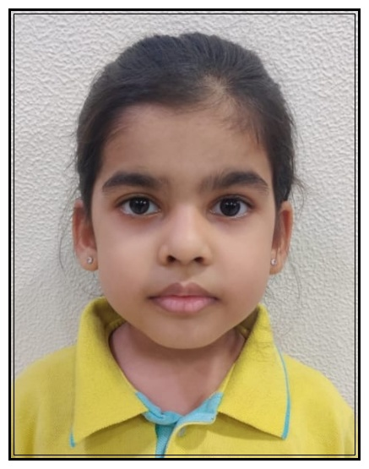
MAHESHWARI PRAGATI MANDAL
MALAD SAMITIES
MALAD UTSAV 2025
⭐⭐⭐⭐⭐
PARIDHI MAHENDRA RATHI
⭐⭐⭐⭐⭐
Parent Name: Mahendra Madanmohan Rathi
Standard: I
Grade A+

Slide 14
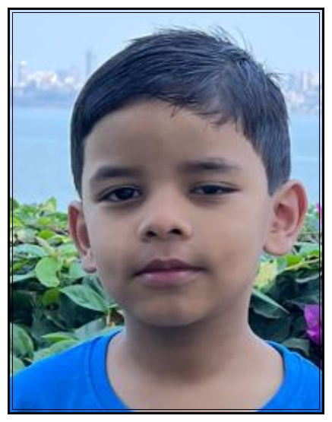
MAHESHWARI PRAGATI MANDAL
MALAD SAMITIES
MALAD UTSAV 2025
⭐⭐⭐⭐⭐
JISHAAN GAGGAR
⭐⭐⭐⭐⭐
Parent Name: Deepali and Ramavtar Gaggar
Standard: I
Grade A1

Slide 15
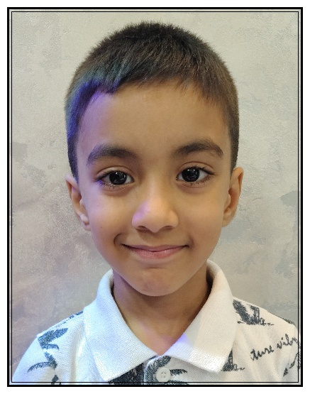
MAHESHWARI PRAGATI MANDAL
MALAD SAMITIES
MALAD UTSAV 2025
⭐⭐⭐⭐⭐
MAANVIK BHOOTRA
⭐⭐⭐⭐⭐
Parent Name: Harish Bhootra
Standard: I
Grade A1

Slide 16
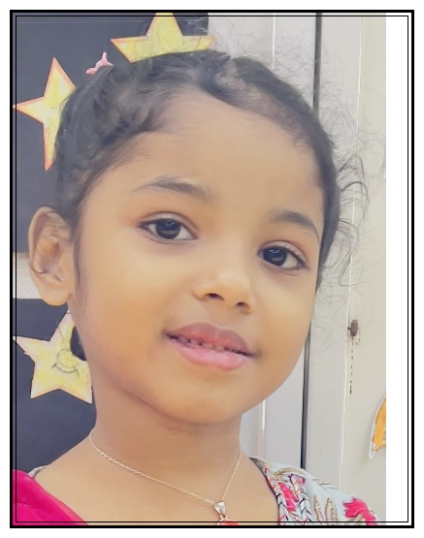
MAHESHWARI PRAGATI MANDAL
MALAD SAMITIES
MALAD UTSAV 2025
⭐⭐⭐⭐⭐
PRISHA TOSHNIWAL
⭐⭐⭐⭐⭐
Parent Name: Mayurkumar Toshniwal
Standard: I
Grade A1

Slide 17
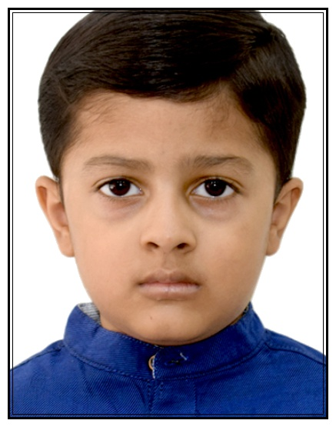
MAHESHWARI PRAGATI MANDAL
MALAD SAMITIES
MALAD UTSAV 2025
⭐⭐⭐⭐⭐
YUVANSH MALPANI
⭐⭐⭐⭐⭐
Parent Name: Sachin Malpani
Standard: I
Grade A1

Slide 18
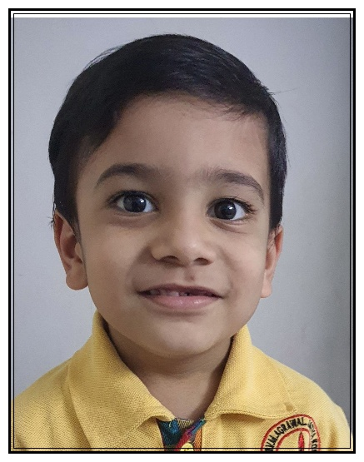
MAHESHWARI PRAGATI MANDAL
MALAD SAMITIES
MALAD UTSAV 2025
⭐⭐⭐⭐⭐
DARSHAN VENKATESH SARDA
⭐⭐⭐⭐⭐
Parent Name: Venkatesh Balkishan Sarda
Standard: II
Grade B

Slide 19
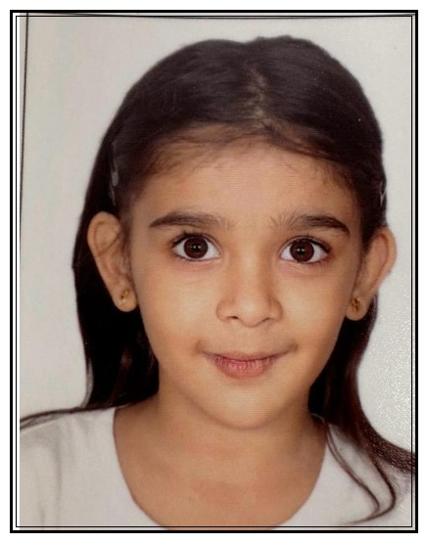
MAHESHWARI PRAGATI MANDAL
MALAD SAMITIES
MALAD UTSAV 2025
⭐⭐⭐⭐⭐
PARISHI MURLI LAHOTI
⭐⭐⭐⭐⭐
Parent Name: Manisha Lahoti
Standard: II
Grade B

Slide 20
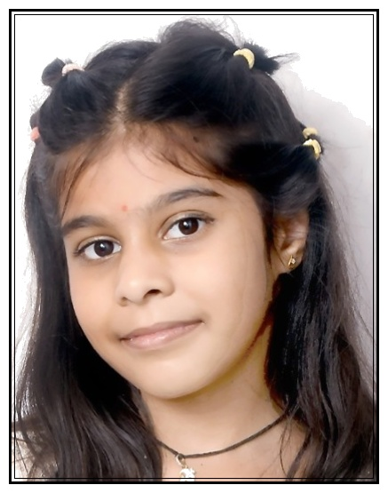
MAHESHWARI PRAGATI MANDAL
MALAD SAMITIES
MALAD UTSAV 2025
⭐⭐⭐⭐⭐
CHAHAL ASHISH SODANI
⭐⭐⭐⭐⭐
Parent Name: Ashish Kumar Sodani
Standard: II
Grade A2

Slide 21
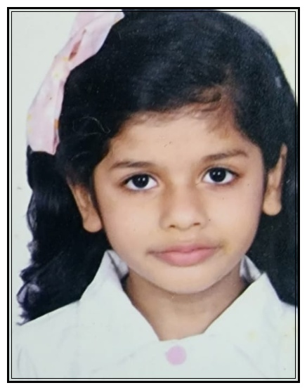
MAHESHWARI PRAGATI MANDAL
MALAD SAMITIES
MALAD UTSAV 2025
⭐⭐⭐⭐⭐
EVANA MAHESHWARI
⭐⭐⭐⭐⭐
Parent Name: Bharat Manisha Maheshwari
Standard: II
Grade A

Slide 22
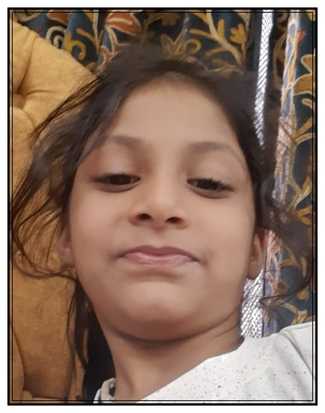
MAHESHWARI PRAGATI MANDAL
MALAD SAMITIES
MALAD UTSAV 2025
⭐⭐⭐⭐⭐
HITIKA GANDHI
⭐⭐⭐⭐⭐
Parent Name: Alekh Gandhi
Standard: II
Grade A

Slide 23
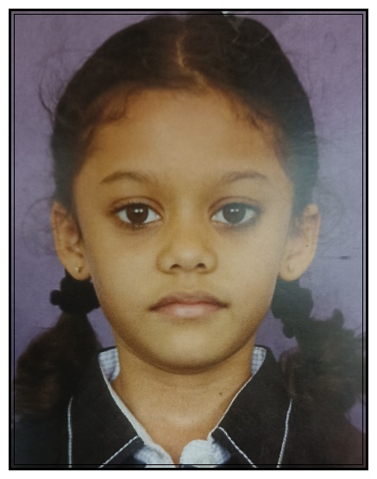
MAHESHWARI PRAGATI MANDAL
MALAD SAMITIES
MALAD UTSAV 2025
⭐⭐⭐⭐⭐
PRISHA SONI
⭐⭐⭐⭐⭐
Parent Name: Dharmendra Soni
Standard: II
Grade A

Slide 24
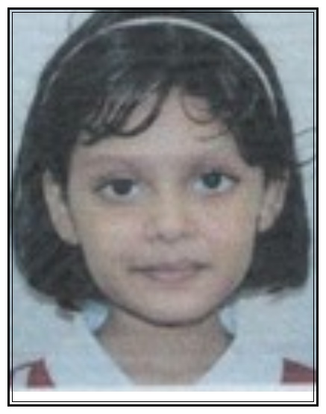
MAHESHWARI PRAGATI MANDAL
MALAD SAMITIES
MALAD UTSAV 2025
⭐⭐⭐⭐⭐
SIA MANDOWARA
⭐⭐⭐⭐⭐
Parent Name: Ashish Mandowara
Standard: II
Grade A

Slide 25
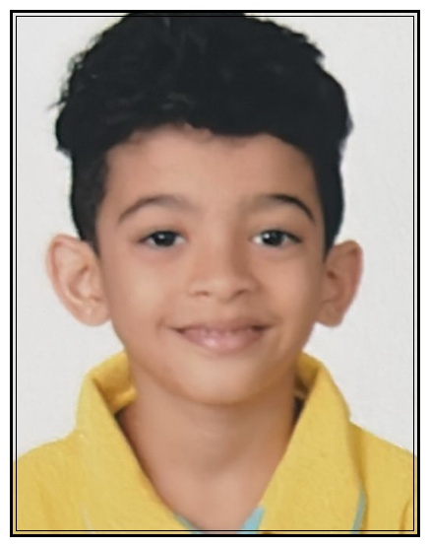
MAHESHWARI PRAGATI MANDAL
MALAD SAMITIES
MALAD UTSAV 2025
⭐⭐⭐⭐⭐
RAGHAV ANUP RATHI
⭐⭐⭐⭐⭐
Parent Name: Anup Madanmohan Rathi
Standard: II
Grade A*

Slide 26
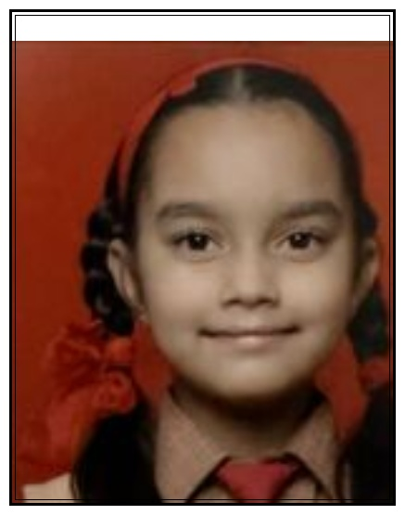
MAHESHWARI PRAGATI MANDAL
MALAD SAMITIES
MALAD UTSAV 2025
⭐⭐⭐⭐⭐
AHANA RATHI
⭐⭐⭐⭐⭐
Parent Name: Harshit Rathi
Standard: II
Grade A+

Slide 27
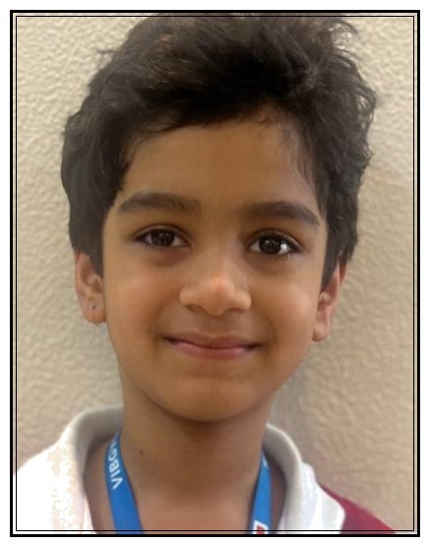
MAHESHWARI PRAGATI MANDAL
MALAD SAMITIES
MALAD UTSAV 2025
⭐⭐⭐⭐⭐
GAURANSH MUCHHAL
⭐⭐⭐⭐⭐
Parent Name: Ankur Muchhal
Standard: II
Grade A+

Slide 28
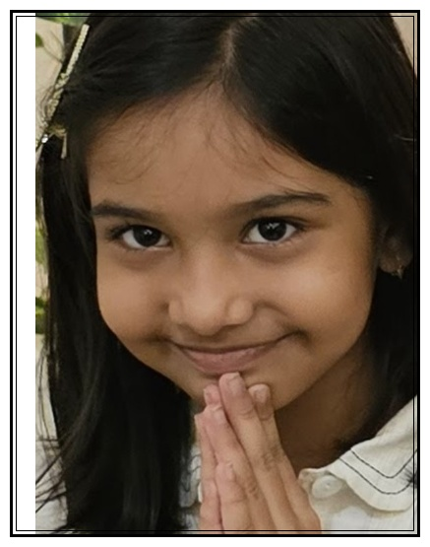
MAHESHWARI PRAGATI MANDAL
MALAD SAMITIES
MALAD UTSAV 2025
⭐⭐⭐⭐⭐
NITAARA DHOOT
⭐⭐⭐⭐⭐
Parent Name: Megha Dhoot
Standard: II
Grade A+

Slide 29
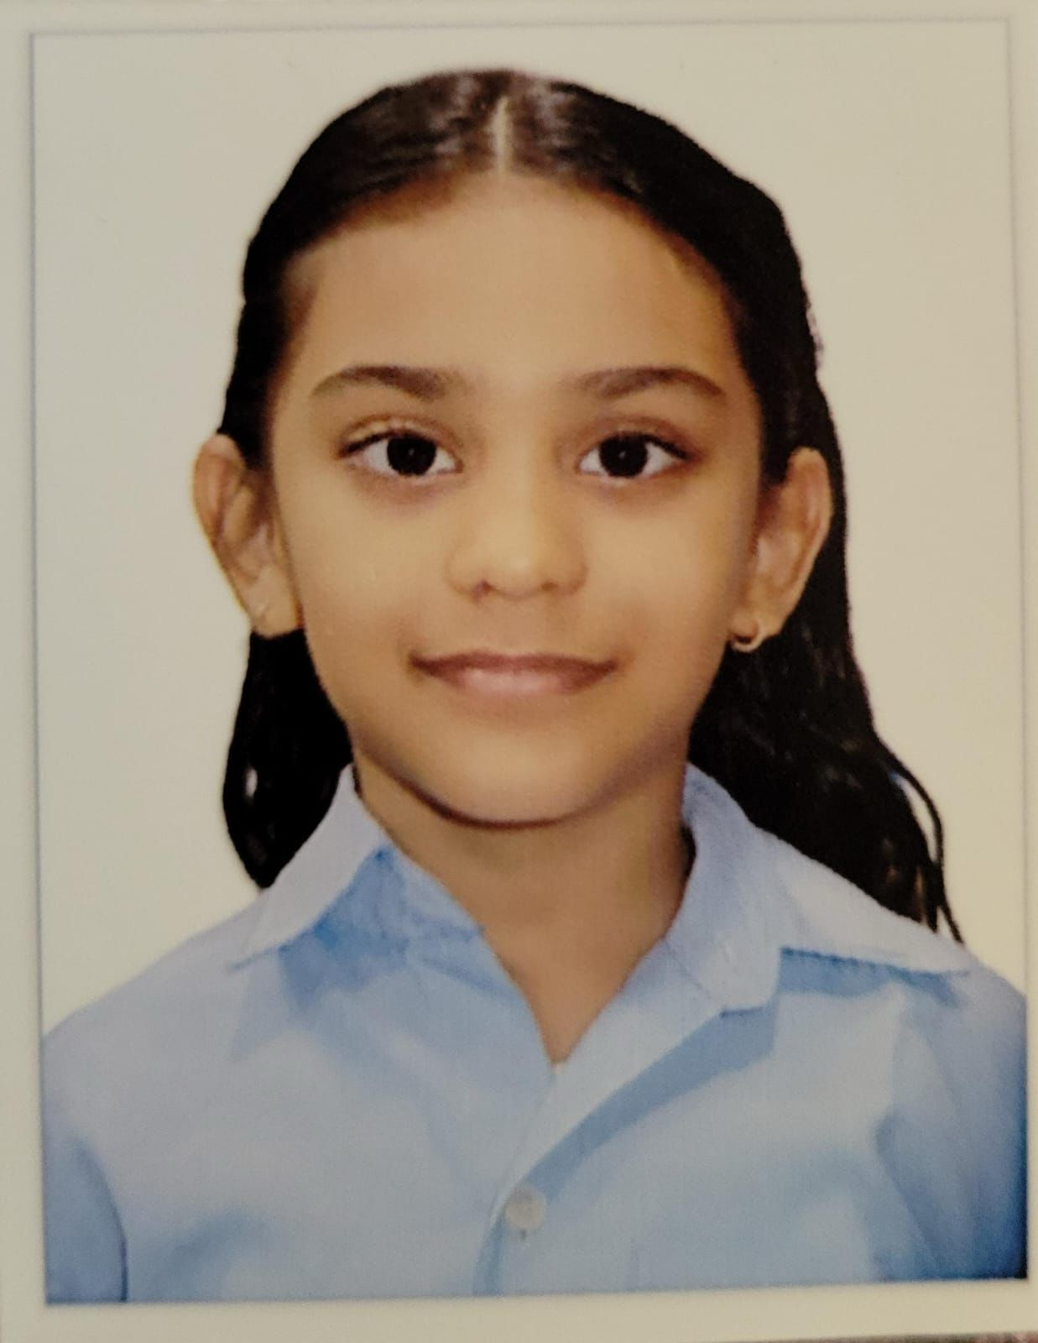
MAHESHWARI PRAGATI MANDAL
MALAD SAMITIES
MALAD UTSAV 2025
⭐⭐⭐⭐⭐
PRAVI MUNDRA
⭐⭐⭐⭐⭐
Parent Name: Monik Mundra
Standard: II
Grade A1

Slide 30
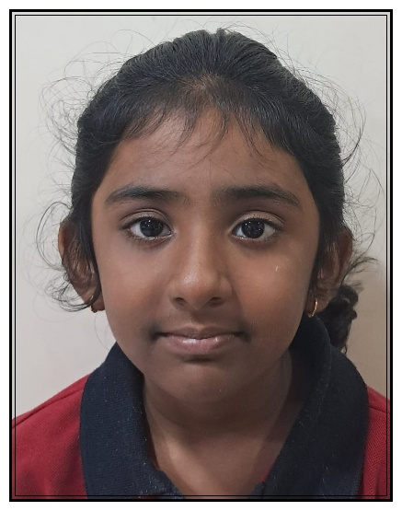
MAHESHWARI PRAGATI MANDAL
MALAD SAMITIES
MALAD UTSAV 2025
⭐⭐⭐⭐⭐
CHAVI GATTANI
⭐⭐⭐⭐⭐
Parent Name: Manoj & Ujwala Gattani
Standard: II
91%

Slide 31
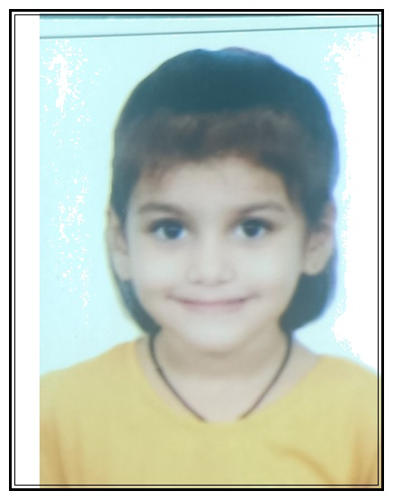
MAHESHWARI PRAGATI MANDAL
MALAD SAMITIES
MALAD UTSAV 2025
⭐⭐⭐⭐⭐
RAYESHA JAJU
⭐⭐⭐⭐⭐
Parent Name: Pawan Jaju
Standard: III
Grade B

Slide 32
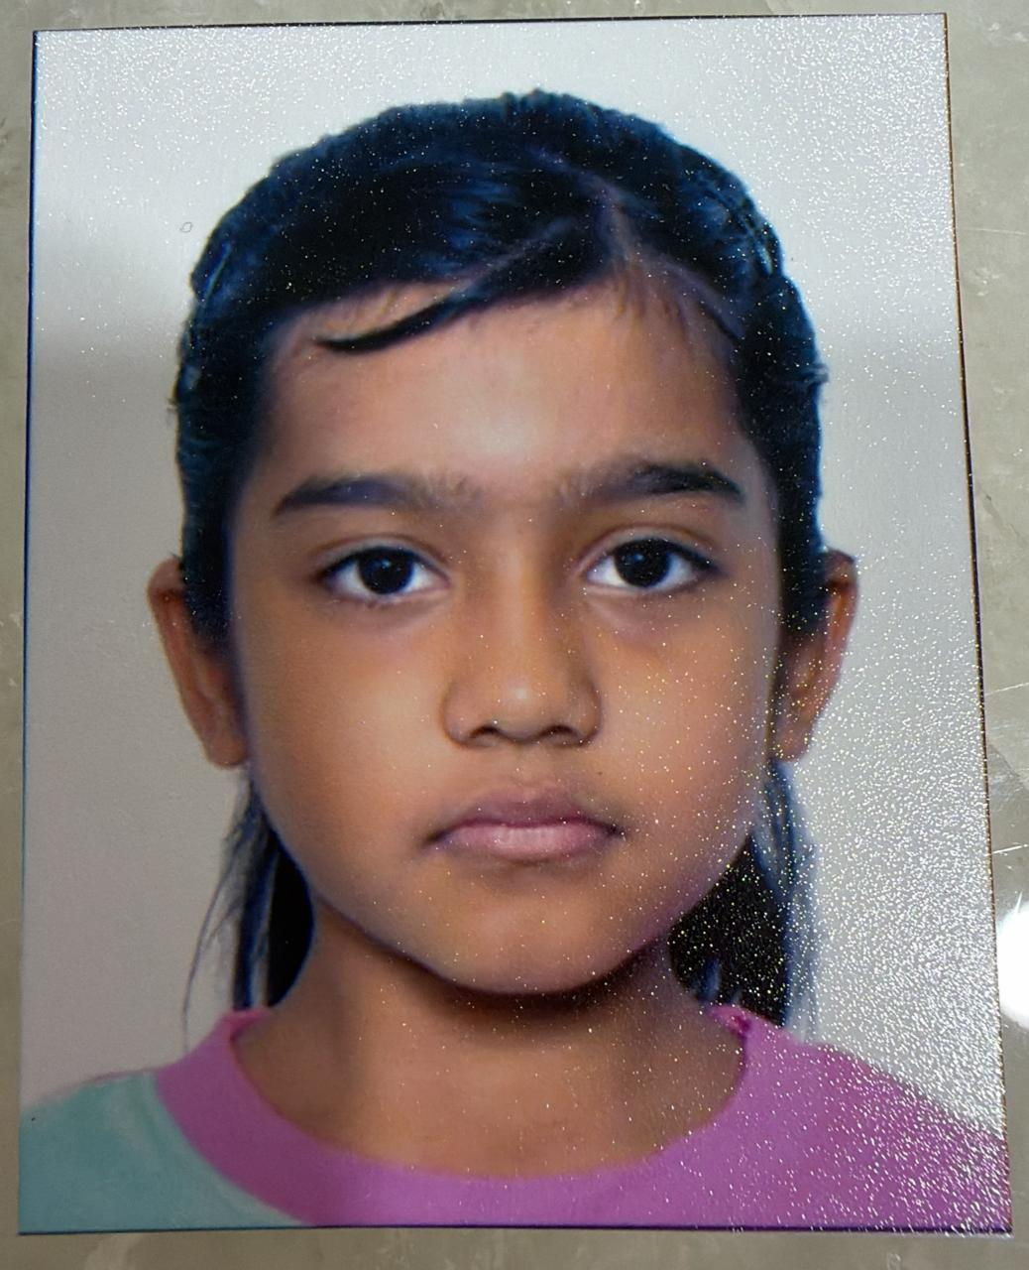
MAHESHWARI PRAGATI MANDAL
MALAD SAMITIES
MALAD UTSAV 2025
⭐⭐⭐⭐⭐
DIA TAWARI
⭐⭐⭐⭐⭐
Parent Name: Mitesh Tawari
Standard: III
Grade A2

Slide 33
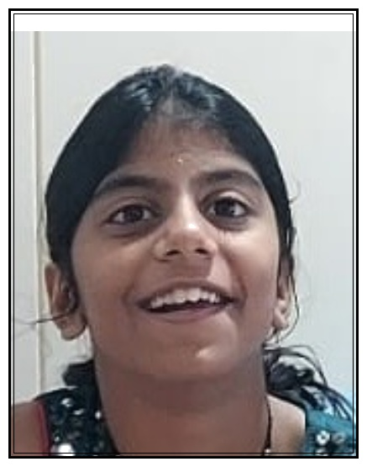
MAHESHWARI PRAGATI MANDAL
MALAD SAMITIES
MALAD UTSAV 2025
⭐⭐⭐⭐⭐
AAHANA ASAWA
⭐⭐⭐⭐⭐
Parent Name: Manish Asawa
Standard: III
Grade A

Slide 34
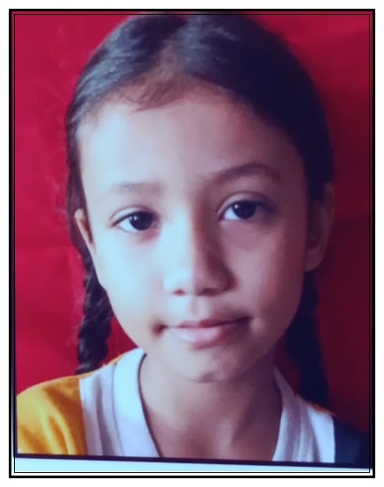
MAHESHWARI PRAGATI MANDAL
MALAD SAMITIES
MALAD UTSAV 2025
⭐⭐⭐⭐⭐
AAHANA AVINASH MANTRI
⭐⭐⭐⭐⭐
Parent Name: Avinash Rajkumar Mantri
Standard: III
Grade A

Slide 35
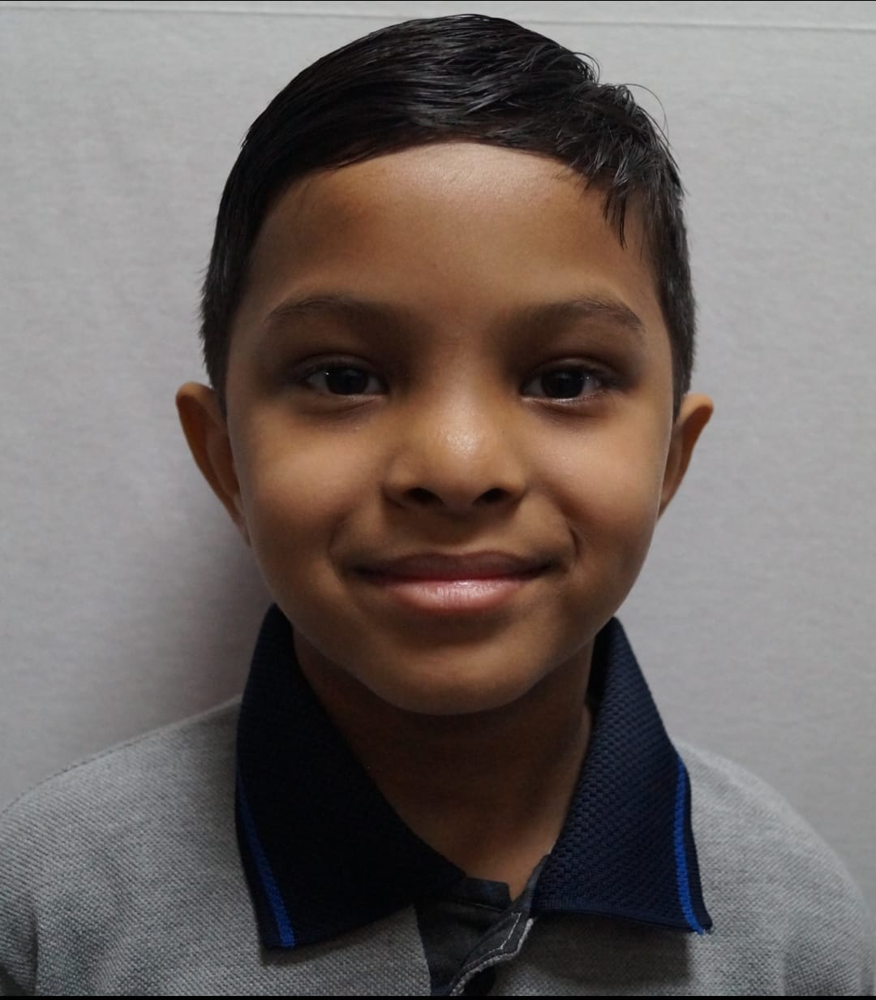
MAHESHWARI PRAGATI MANDAL
MALAD SAMITIES
MALAD UTSAV 2025
⭐⭐⭐⭐⭐
GARVIT VATAN MAHESHWARI
⭐⭐⭐⭐⭐
Parent Name: Vatan Maheshwari
Standard: III
Grade A

Slide 36
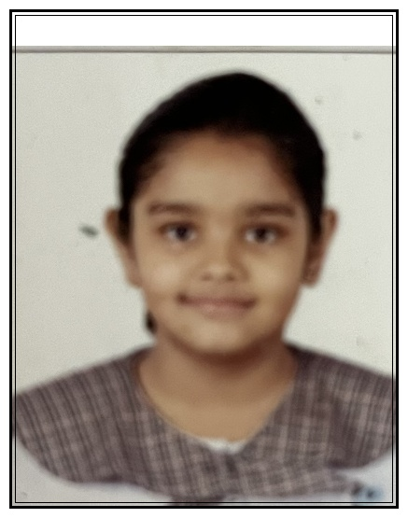
MAHESHWARI PRAGATI MANDAL
MALAD SAMITIES
MALAD UTSAV 2025
⭐⭐⭐⭐⭐
MOKSHI BHATTAR
⭐⭐⭐⭐⭐
Parent Name: Ranu Bhattar
Standard: III
Grade A

Slide 37
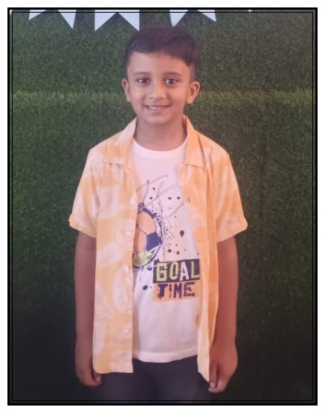
MAHESHWARI PRAGATI MANDAL
MALAD SAMITIES
MALAD UTSAV 2025
⭐⭐⭐⭐⭐
RAKSHIT SOMANI
⭐⭐⭐⭐⭐
Parent Name: Sanwariya Somani
Standard: III
Grade A

Slide 38
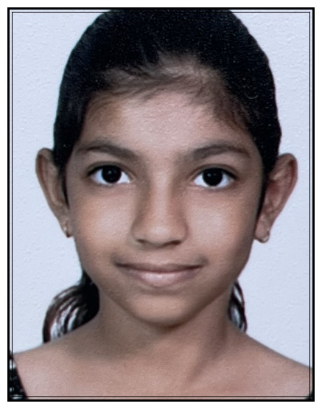
MAHESHWARI PRAGATI MANDAL
MALAD SAMITIES
MALAD UTSAV 2025
⭐⭐⭐⭐⭐
YASHVI SONI
⭐⭐⭐⭐⭐
Parent Name: Kalpana Soni
Standard: III
Grade A

Slide 39
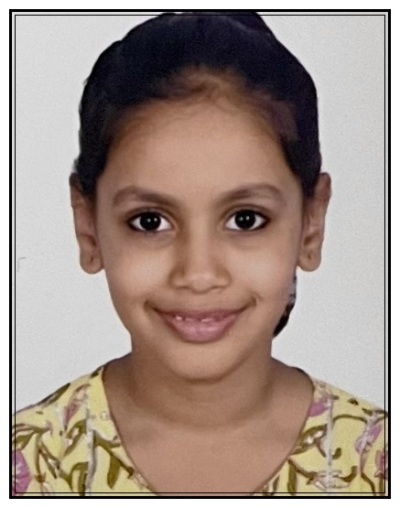
MAHESHWARI PRAGATI MANDAL
MALAD SAMITIES
MALAD UTSAV 2025
⭐⭐⭐⭐⭐
KASHVI MAHESHWARI
⭐⭐⭐⭐⭐
Parent Name: Arun Baldwa
Standard: III
Grade A+

Slide 40
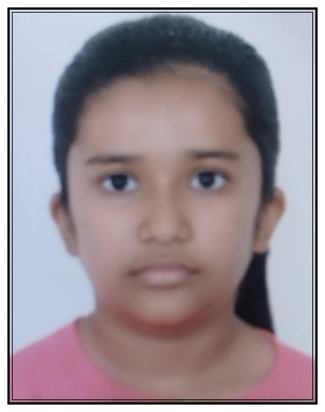
MAHESHWARI PRAGATI MANDAL
MALAD SAMITIES
MALAD UTSAV 2025
⭐⭐⭐⭐⭐
KRISHA KABRA
⭐⭐⭐⭐⭐
Parent Name: Vivek Kabra
Standard: III
Grade A+

Slide 41
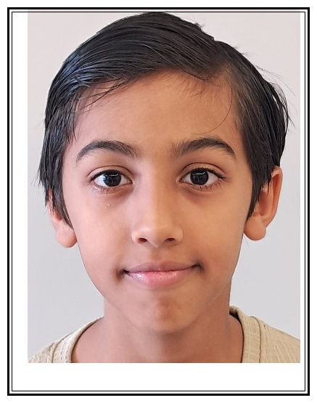
MAHESHWARI PRAGATI MANDAL
MALAD SAMITIES
MALAD UTSAV 2025
⭐⭐⭐⭐⭐
PARTH PARAG BOOB
⭐⭐⭐⭐⭐
Parent Name: Parag Boob
Standard: III
Grade A+

Slide 42
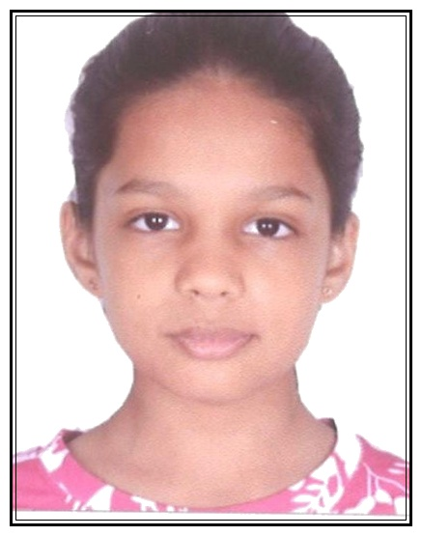
MAHESHWARI PRAGATI MANDAL
MALAD SAMITIES
MALAD UTSAV 2025
⭐⭐⭐⭐⭐
SHREEDA BAHETI
⭐⭐⭐⭐⭐
Parent Name: Nandkishor Baheti
Standard: III
Grade A+

Slide 43
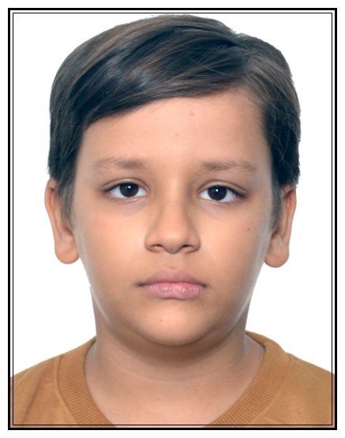
MAHESHWARI PRAGATI MANDAL
MALAD SAMITIES
MALAD UTSAV 2025
⭐⭐⭐⭐⭐
DEVANSH DHOOT
⭐⭐⭐⭐⭐
Parent Name: Prateek Dhoot
Standard: III
Grade A1

Slide 44
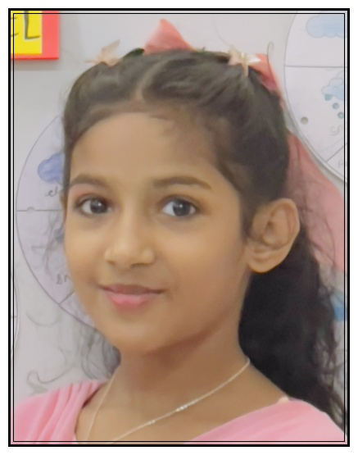
MAHESHWARI PRAGATI MANDAL
MALAD SAMITIES
MALAD UTSAV 2025
⭐⭐⭐⭐⭐
VEDIKA TOSHNIWAL
⭐⭐⭐⭐⭐
Parent Name: Mayurkumar Toshniwal
Standard: III
Grade A1

Slide 45
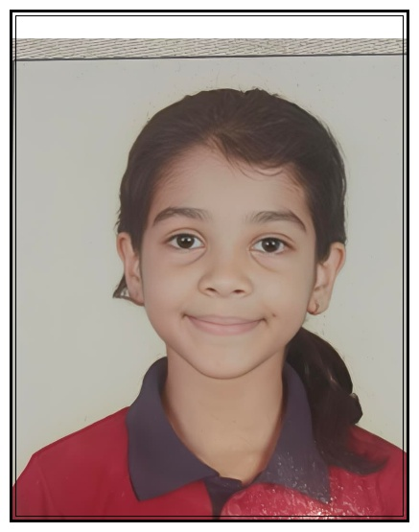
MAHESHWARI PRAGATI MANDAL
MALAD SAMITIES
MALAD UTSAV 2025
⭐⭐⭐⭐⭐
SUMAIRA DHOOT
⭐⭐⭐⭐⭐
Parent Name: Sachin Dhoot
Standard: III
77%

Slide 46
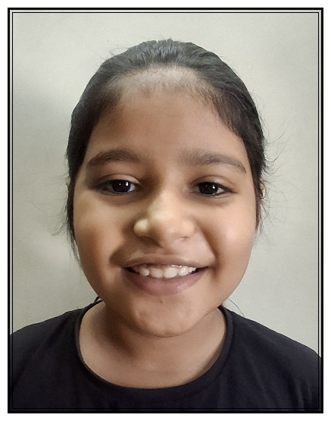
MAHESHWARI PRAGATI MANDAL
MALAD SAMITIES
MALAD UTSAV 2025
⭐⭐⭐⭐⭐
ISHITA MUNDHRA
⭐⭐⭐⭐⭐
Parent Name: Pradeep Mundhra
Standard: III
87%

Slide 47
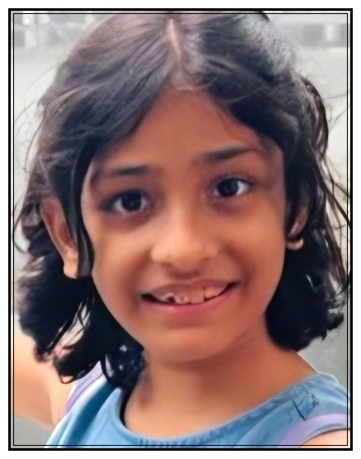
MAHESHWARI PRAGATI MANDAL
MALAD SAMITIES
MALAD UTSAV 2025
⭐⭐⭐⭐⭐
MISHTI KALANTRI
⭐⭐⭐⭐⭐
Parent Name: Umesh Kalantri
Standard: IV
Grade B

Slide 48
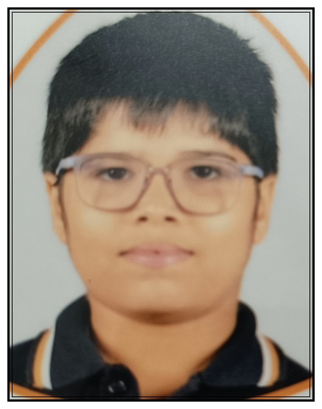
MAHESHWARI PRAGATI MANDAL
MALAD SAMITIES
MALAD UTSAV 2025
⭐⭐⭐⭐⭐
VATSAL MAHESHWARI
⭐⭐⭐⭐⭐
Parent Name: Nikhil Maheshwari
Standard: IV
Grade A2

Slide 49
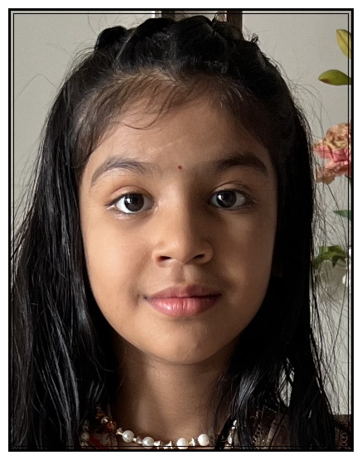
MAHESHWARI PRAGATI MANDAL
MALAD SAMITIES
MALAD UTSAV 2025
⭐⭐⭐⭐⭐
AASHVI BAHETI
⭐⭐⭐⭐⭐
Parent Name: Laxmi Narayan and Deepika Baheti
Standard: IV
Grade A

Slide 50
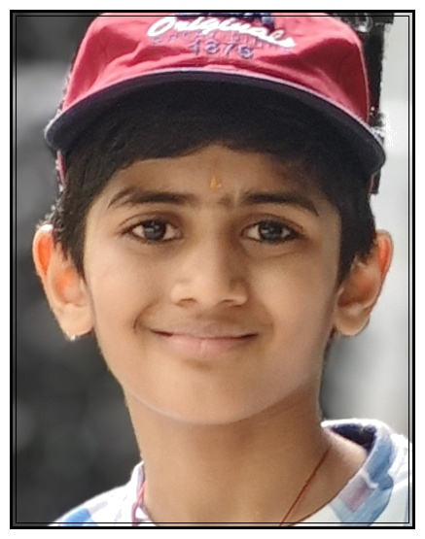
MAHESHWARI PRAGATI MANDAL
MALAD SAMITIES
MALAD UTSAV 2025
⭐⭐⭐⭐⭐
TAVISH RATHI
⭐⭐⭐⭐⭐
Parent Name: Vikas Kumar Rathi
Standard: IV
Grade A

Slide 51

MAHESHWARI PRAGATI MANDAL
MALAD SAMITIES
MALAD UTSAV 2025
⭐⭐⭐⭐⭐
VIRAT JAJOO
⭐⭐⭐⭐⭐
Parent Name: Vikas Jajoo
Standard: IV
Grade A

Slide 52

MAHESHWARI PRAGATI MANDAL
MALAD SAMITIES
MALAD UTSAV 2025
⭐⭐⭐⭐⭐
YUVAAN RATHI
⭐⭐⭐⭐⭐
Parent Name: Pooja Rathi
Standard: IV
Grade A

Slide 53

MAHESHWARI PRAGATI MANDAL
MALAD SAMITIES
MALAD UTSAV 2025
⭐⭐⭐⭐⭐
DARSH MUNDRA
⭐⭐⭐⭐⭐
Parent Name: Monik Mundra
Standard: IV
Grade A1

Slide 54

MAHESHWARI PRAGATI MANDAL
MALAD SAMITIES
MALAD UTSAV 2025
⭐⭐⭐⭐⭐
JASH NARENDRA SONI
⭐⭐⭐⭐⭐
Parent Name: Narendra P Soni
Standard: IV
Grade A*

Slide 55

MAHESHWARI PRAGATI MANDAL
MALAD SAMITIES
MALAD UTSAV 2025
⭐⭐⭐⭐⭐
SAMAR SOMANI
⭐⭐⭐⭐⭐
Parent Name: Sumit Somani
Standard: IV
Grade A*

Slide 56

MAHESHWARI PRAGATI MANDAL
MALAD SAMITIES
MALAD UTSAV 2025
⭐⭐⭐⭐⭐
YAKSH MUNDHRA
⭐⭐⭐⭐⭐
Parent Name: Ramesh Mundhra
Standard: IV
83%

Slide 57

MAHESHWARI PRAGATI MANDAL
MALAD SAMITIES
MALAD UTSAV 2025
⭐⭐⭐⭐⭐
NIVAAN DHOOT
⭐⭐⭐⭐⭐
Parent Name: Kushal Dhoot
Standard: IV
88%

Slide 58

MAHESHWARI PRAGATI MANDAL
MALAD SAMITIES
MALAD UTSAV 2025
⭐⭐⭐⭐⭐
VAANI CHANDAK
⭐⭐⭐⭐⭐
Parent Name: Manmohan Chandak
Standard: IV
93%

Slide 59

MAHESHWARI PRAGATI MANDAL
MALAD SAMITIES
MALAD UTSAV 2025
⭐⭐⭐⭐⭐
DRISHTI ASHWIN SONI
⭐⭐⭐⭐⭐
Parent Name: Ashwin Soni, Shweta Soni
Standard: V
Grade A*

Slide 60

MAHESHWARI PRAGATI MANDAL
MALAD SAMITIES
MALAD UTSAV 2025
⭐⭐⭐⭐⭐
RACHIT MOONDRA
⭐⭐⭐⭐⭐
Parent Name: Ratish Moondra
Standard: V
Grade A1

Slide 61

MAHESHWARI PRAGATI MANDAL
MALAD SAMITIES
MALAD UTSAV 2025
⭐⭐⭐⭐⭐
RAGHAV GATTANI
⭐⭐⭐⭐⭐
Parent Name: Puja Gattani
Standard: V
86%

Slide 62

MAHESHWARI PRAGATI MANDAL
MALAD SAMITIES
MALAD UTSAV 2025
⭐⭐⭐⭐⭐
NIRAV BHOOTRA
⭐⭐⭐⭐⭐
Parent Name: Harish Bhootra
Standard: V
89%

Slide 63

MAHESHWARI PRAGATI MANDAL
MALAD SAMITIES
MALAD UTSAV 2025
⭐⭐⭐⭐⭐
PANKHURI KASAT
⭐⭐⭐⭐⭐
Parent Name: Manish Kasat
Standard: V
89%

Slide 64

MAHESHWARI PRAGATI MANDAL
MALAD SAMITIES
MALAD UTSAV 2025
⭐⭐⭐⭐⭐
SHAURYA KASAT
⭐⭐⭐⭐⭐
Parent Name: Manish Kasat
Standard: V
90%

Slide 65

MAHESHWARI PRAGATI MANDAL
MALAD SAMITIES
MALAD UTSAV 2025
⭐⭐⭐⭐⭐
MANIT BHUTRA
⭐⭐⭐⭐⭐
Parent Name: Varsha - Sumit Bhutra
Standard: V
93%

Slide 66

MAHESHWARI PRAGATI MANDAL
MALAD SAMITIES
MALAD UTSAV 2025
⭐⭐⭐⭐⭐
PAVIT HEMANTKUMAR BAHEDIA
⭐⭐⭐⭐⭐
Parent Name: Hemantkumar Shyamsundar Bahedia
Standard: V
95%

Slide 67

MAHESHWARI PRAGATI MANDAL
MALAD SAMITIES
MALAD UTSAV 2025
⭐⭐⭐⭐⭐
TAVISHI KOTHARI
⭐⭐⭐⭐⭐
Parent Name: Abhishek Kothari
Standard: V
97%

Slide 68

MAHESHWARI PRAGATI MANDAL
MALAD SAMITIES
MALAD UTSAV 2025
⭐⭐⭐⭐⭐
SHREYA KANKANI
⭐⭐⭐⭐⭐
Parent Name: Ramanuj C Kankani
Standard: VI
Grade B

Slide 69

MAHESHWARI PRAGATI MANDAL
MALAD SAMITIES
MALAD UTSAV 2025
⭐⭐⭐⭐⭐
KAVYA TAPARIA
⭐⭐⭐⭐⭐
Parent Name: Prem Taparia
Standard: VI
Grade A2

Slide 70

MAHESHWARI PRAGATI MANDAL
MALAD SAMITIES
MALAD UTSAV 2025
⭐⭐⭐⭐⭐
TAVISHA BIYANI
⭐⭐⭐⭐⭐
Parent Name: Chhaya Biyani
Standard: VI
Grade A2

Slide 71

MAHESHWARI PRAGATI MANDAL
MALAD SAMITIES
MALAD UTSAV 2025
⭐⭐⭐⭐⭐
PRACHITA SINGHI
⭐⭐⭐⭐⭐
Parent Name: Priyanka Singhi
Standard: VI
Grade A1

Slide 72

MAHESHWARI PRAGATI MANDAL
MALAD SAMITIES
MALAD UTSAV 2025
⭐⭐⭐⭐⭐
KAVYA NILESH TAWARI
⭐⭐⭐⭐⭐
Parent Name: Nilesh Tawari
Standard: VI
Grade A+

Slide 73

MAHESHWARI PRAGATI MANDAL
MALAD SAMITIES
MALAD UTSAV 2025
⭐⭐⭐⭐⭐
RIDDHAM NAWAL
⭐⭐⭐⭐⭐
Parent Name: Mona Deepak Nawal
Standard: VI
Grade A+

Slide 74

MAHESHWARI PRAGATI MANDAL
MALAD SAMITIES
MALAD UTSAV 2025
⭐⭐⭐⭐⭐
RIDDHIMA NAWAL
⭐⭐⭐⭐⭐
Parent Name: Mona Deepak Nawal
Standard: VI
Grade A+

Slide 75

MAHESHWARI PRAGATI MANDAL
MALAD SAMITIES
MALAD UTSAV 2025
⭐⭐⭐⭐⭐
RIDHIMA PANSARI
⭐⭐⭐⭐⭐
Parent Name: Vishal Pansari
Standard: VI
Grade A+

Slide 76

MAHESHWARI PRAGATI MANDAL
MALAD SAMITIES
MALAD UTSAV 2025
⭐⭐⭐⭐⭐
AAHANA DHUPAR
⭐⭐⭐⭐⭐
Parent Name: Ashish Dhupar
Standard: VI
77%

Slide 77

MAHESHWARI PRAGATI MANDAL
MALAD SAMITIES
MALAD UTSAV 2025
⭐⭐⭐⭐⭐
KESHAV RATHI
⭐⭐⭐⭐⭐
Parent Name: Urmila Ankit Rathi
Standard: VI
78%

Slide 78

MAHESHWARI PRAGATI MANDAL
MALAD SAMITIES
MALAD UTSAV 2025
⭐⭐⭐⭐⭐
KAVISH DAMANI
⭐⭐⭐⭐⭐
Parent Name: Payal and Shashank Damani
Standard: VI
84%

Slide 79

MAHESHWARI PRAGATI MANDAL
MALAD SAMITIES
MALAD UTSAV 2025
⭐⭐⭐⭐⭐
VIHAN DAGA
⭐⭐⭐⭐⭐
Parent Name: Aditya Daga
Standard: VI
85%

Slide 80

MAHESHWARI PRAGATI MANDAL
MALAD SAMITIES
MALAD UTSAV 2025
⭐⭐⭐⭐⭐
RHEA SATISH KALANTRI
⭐⭐⭐⭐⭐
Parent Name: Satish Purushottam Kalantri
Standard: VI
87%

Slide 81

MAHESHWARI PRAGATI MANDAL
MALAD SAMITIES
MALAD UTSAV 2025
⭐⭐⭐⭐⭐
VRINDA MUNDHRA
⭐⭐⭐⭐⭐
Parent Name: Ramesh Mundhra
Standard: VI
88%

Slide 82

MAHESHWARI PRAGATI MANDAL
MALAD SAMITIES
MALAD UTSAV 2025
⭐⭐⭐⭐⭐
KRIYANSH RATHI
⭐⭐⭐⭐⭐
Parent Name: Shweta Rathi
Standard: VI
89%

Slide 83

MAHESHWARI PRAGATI MANDAL
MALAD SAMITIES
MALAD UTSAV 2025
⭐⭐⭐⭐⭐
DHAIRYA TAWARI
⭐⭐⭐⭐⭐
Parent Name: Mitesh Tawari
Standard: VII
Grade A2

Slide 84

MAHESHWARI PRAGATI MANDAL
MALAD SAMITIES
MALAD UTSAV 2025
⭐⭐⭐⭐⭐
VIHAAN LOHIA
⭐⭐⭐⭐⭐
Parent Name: Diti Lohia
Standard: VII
Grade A

Slide 85

MAHESHWARI PRAGATI MANDAL
MALAD SAMITIES
MALAD UTSAV 2025
⭐⭐⭐⭐⭐
KASHVI MUCHHAL
⭐⭐⭐⭐⭐
Parent Name: Ankur Muchhal
Standard: VII
Grade A+

Slide 86

MAHESHWARI PRAGATI MANDAL
MALAD SAMITIES
MALAD UTSAV 2025
⭐⭐⭐⭐⭐
MISHIKA BIYANI
⭐⭐⭐⭐⭐
Parent Name: Pradeep Biyani
Standard: VII
81%

Slide 87

MAHESHWARI PRAGATI MANDAL
MALAD SAMITIES
MALAD UTSAV 2025
⭐⭐⭐⭐⭐
DEHUTI BHAIYYA
⭐⭐⭐⭐⭐
Parent Name: Ashish Poonam Bhaiyya
Standard: VII
86%

Slide 88

MAHESHWARI PRAGATI MANDAL
MALAD SAMITIES
MALAD UTSAV 2025
⭐⭐⭐⭐⭐
VANSHIKA KABRA
⭐⭐⭐⭐⭐
Parent Name: Arti Kabra
Standard: VII
86%

Slide 89

MAHESHWARI PRAGATI MANDAL
MALAD SAMITIES
MALAD UTSAV 2025
⭐⭐⭐⭐⭐
SHREYANSH MALPANI
⭐⭐⭐⭐⭐
Parent Name: Natvarlal Malpani
Standard: VII
89%

Slide 90

MAHESHWARI PRAGATI MANDAL
MALAD SAMITIES
MALAD UTSAV 2025
⭐⭐⭐⭐⭐
SHIVANSH RATHI
⭐⭐⭐⭐⭐
Parent Name: Vishnu Rathi
Standard: VII
90%

Slide 91

MAHESHWARI PRAGATI MANDAL
MALAD SAMITIES
MALAD UTSAV 2025
⭐⭐⭐⭐⭐
DARSH SAWNA
⭐⭐⭐⭐⭐
Parent Name: Jaishree Sawna
Standard: VII
91%

Slide 92

MAHESHWARI PRAGATI MANDAL
MALAD SAMITIES
MALAD UTSAV 2025
⭐⭐⭐⭐⭐
RUTVI BHUTRA
⭐⭐⭐⭐⭐
Parent Name: Varsha Bhutra - Sumit Bhutra
Standard: VII
93%

Slide 93

MAHESHWARI PRAGATI MANDAL
MALAD SAMITIES
MALAD UTSAV 2025
⭐⭐⭐⭐⭐
VIVAAN BAHETI
⭐⭐⭐⭐⭐
Parent Name: Nandkishor Baheti
Standard: VII
97%

Slide 94

MAHESHWARI PRAGATI MANDAL
MALAD SAMITIES
MALAD UTSAV 2025
⭐⭐⭐⭐⭐
ADVAIT CHAUDHARY (KAKANI)
⭐⭐⭐⭐⭐
Parent Name: Anand Chaudhary (Kakani )
Standard: VIII
Grade A

Slide 95

MAHESHWARI PRAGATI MANDAL
MALAD SAMITIES
MALAD UTSAV 2025
⭐⭐⭐⭐⭐
AKSHITA RAHUL ASSAWA
⭐⭐⭐⭐⭐
Parent Name: Rahul & Suchika Assawa
Standard: VIII
Grade A+

Slide 96

MAHESHWARI PRAGATI MANDAL
MALAD SAMITIES
MALAD UTSAV 2025
⭐⭐⭐⭐⭐
HARSH GAGGAR
⭐⭐⭐⭐⭐
Parent Name: Neeta and Kailash kumar Gaggar
Standard: VIII
77%

Slide 97

MAHESHWARI PRAGATI MANDAL
MALAD SAMITIES
MALAD UTSAV 2025
⭐⭐⭐⭐⭐
YAJAT CHANDAK
⭐⭐⭐⭐⭐
Parent Name: Nikhil Chandak
Standard: VIII
78%

Slide 98

MAHESHWARI PRAGATI MANDAL
MALAD SAMITIES
MALAD UTSAV 2025
⭐⭐⭐⭐⭐
DIYA GAGGAR
⭐⭐⭐⭐⭐
Parent Name: Deepali and Ramavtar Gaggar
Standard: VIII
81%

Slide 99

MAHESHWARI PRAGATI MANDAL
MALAD SAMITIES
MALAD UTSAV 2025
⭐⭐⭐⭐⭐
JIYA KALANTRI
⭐⭐⭐⭐⭐
Parent Name: Umesh Kalantri
Standard: VIII
84%

Slide 100

MAHESHWARI PRAGATI MANDAL
MALAD SAMITIES
MALAD UTSAV 2025
⭐⭐⭐⭐⭐
SHRIYA DAMANI
⭐⭐⭐⭐⭐
Parent Name: Payal and Shashank Damani
Standard: VIII
85%

Slide 101

MAHESHWARI PRAGATI MANDAL
MALAD SAMITIES
MALAD UTSAV 2025
⭐⭐⭐⭐⭐
AAROH GANDHI
⭐⭐⭐⭐⭐
Parent Name: Alekh Gandhi
Standard: VIII
90%

Slide 102

MAHESHWARI PRAGATI MANDAL
MALAD SAMITIES
MALAD UTSAV 2025
⭐⭐⭐⭐⭐
AYUSHI RAJESH BIRLA
⭐⭐⭐⭐⭐
Parent Name: Rajesh Balkishan Birla
Standard: VIII
90%

Slide 103

MAHESHWARI PRAGATI MANDAL
MALAD SAMITIES
MALAD UTSAV 2025
⭐⭐⭐⭐⭐
DEVANSH BAHETI
⭐⭐⭐⭐⭐
Parent Name: Laxmi Narayan Baheti
Standard: VIII
90%

Slide 104

MAHESHWARI PRAGATI MANDAL
MALAD SAMITIES
MALAD UTSAV 2025
⭐⭐⭐⭐⭐
THWISHA RAVINDRA BANG
⭐⭐⭐⭐⭐
Parent Name: Ravindra Purushottam Bang
Standard: VIII
90%

Slide 105

MAHESHWARI PRAGATI MANDAL
MALAD SAMITIES
MALAD UTSAV 2025
⭐⭐⭐⭐⭐
KHUSH DHOOT
⭐⭐⭐⭐⭐
Parent Name: Sachin Dhoot
Standard: VIII
95%

Slide 106

MAHESHWARI PRAGATI MANDAL
MALAD SAMITIES
MALAD UTSAV 2025
⭐⭐⭐⭐⭐
AAYUSHMAN BHALA
⭐⭐⭐⭐⭐
Parent Name: Ashish Bhala
Standard: IX
76%

Slide 107

MAHESHWARI PRAGATI MANDAL
MALAD SAMITIES
MALAD UTSAV 2025
⭐⭐⭐⭐⭐
BHAVYA BIYANI
⭐⭐⭐⭐⭐
Parent Name: Pankaj Biyani
Standard: IX
83%

Slide 108

MAHESHWARI PRAGATI MANDAL
MALAD SAMITIES
MALAD UTSAV 2025
⭐⭐⭐⭐⭐
GORAL SOMANI
⭐⭐⭐⭐⭐
Parent Name: Gopal and Archana Somani
Standard: IX
83%

Slide 109

MAHESHWARI PRAGATI MANDAL
MALAD SAMITIES
MALAD UTSAV 2025
⭐⭐⭐⭐⭐
VEDIKA ASAWA
⭐⭐⭐⭐⭐
Parent Name: Jayprakash Asawa
Standard: IX
84%

Slide 110

MAHESHWARI PRAGATI MANDAL
MALAD SAMITIES
MALAD UTSAV 2025
⭐⭐⭐⭐⭐
AAROHI MOHTA
⭐⭐⭐⭐⭐
Parent Name: Giriraj Mohta
Standard: IX
95%

Slide 111

MAHESHWARI PRAGATI MANDAL
MALAD SAMITIES
MALAD UTSAV 2025
⭐⭐⭐⭐⭐
BHAVYA MAHENDRA RATHI
⭐⭐⭐⭐⭐
Parent Name: Mahendra Ramnarayan Rathi
Standard: X
81%

Slide 112

MAHESHWARI PRAGATI MANDAL
MALAD SAMITIES
MALAD UTSAV 2025
⭐⭐⭐⭐⭐
HIYA MAHENDRA RATHI
⭐⭐⭐⭐⭐
Parent Name: Mahendra Madanmohan Rathi
Standard: X
84%

Slide 113

MAHESHWARI PRAGATI MANDAL
MALAD SAMITIES
MALAD UTSAV 2025
⭐⭐⭐⭐⭐
RISHIT MAHESHWARI
⭐⭐⭐⭐⭐
Parent Name: Harish Maheshwari
Standard: X
85%

Slide 114

MAHESHWARI PRAGATI MANDAL
MALAD SAMITIES
MALAD UTSAV 2025
⭐⭐⭐⭐⭐
VEDIKA VISHNU TOSHNIWAL
⭐⭐⭐⭐⭐
Parent Name: Vishnu Satyanarayan Toshniwal
Standard: X
89%

Slide 115

MAHESHWARI PRAGATI MANDAL
MALAD SAMITIES
MALAD UTSAV 2025
⭐⭐⭐⭐⭐
NARAYAN ANIL ASAWA
⭐⭐⭐⭐⭐
Parent Name: Anil Asawa
Standard: X
90%

Slide 116

MAHESHWARI PRAGATI MANDAL
MALAD SAMITIES
MALAD UTSAV 2025
⭐⭐⭐⭐⭐
JAYATI RAHUL RATHI
⭐⭐⭐⭐⭐
Parent Name: Rahul Rathi
Standard: X
91%

Slide 117

MAHESHWARI PRAGATI MANDAL
MALAD SAMITIES
MALAD UTSAV 2025
⭐⭐⭐⭐⭐
DHRUV KABRA
⭐⭐⭐⭐⭐
Parent Name: Surendra Kabra
Standard: X
94%

Slide 118

MAHESHWARI PRAGATI MANDAL
MALAD SAMITIES
MALAD UTSAV 2025
⭐⭐⭐⭐⭐
JAI TOSHNIWAL
⭐⭐⭐⭐⭐
Parent Name: Meena Toshniwal
Standard: X
94%

Slide 119

MAHESHWARI PRAGATI MANDAL
MALAD SAMITIES
MALAD UTSAV 2025
⭐⭐⭐⭐⭐
SANSKRITI PUGALIA
⭐⭐⭐⭐⭐
Parent Name: Ashish Pugalia
Standard: X
94%

Slide 120

MAHESHWARI PRAGATI MANDAL
MALAD SAMITIES
MALAD UTSAV 2025
⭐⭐⭐⭐⭐
MADHAV JHAWAR
⭐⭐⭐⭐⭐
Parent Name: Ajay Jhanwar
Standard: X
96%

Slide 121

MAHESHWARI PRAGATI MANDAL
MALAD SAMITIES
MALAD UTSAV 2025
⭐⭐⭐⭐⭐
TANISI MADHUSUDAN SARDA
⭐⭐⭐⭐⭐
Parent Name: Madhusudan N Sarda
Standard: X
97%

Slide 122

MAHESHWARI PRAGATI MANDAL
MALAD SAMITIES
MALAD UTSAV 2025
⭐⭐⭐⭐⭐
YASH MALANI
⭐⭐⭐⭐⭐
Parent Name: Nilesh Malani
Standard: X
98%

Slide 123

MAHESHWARI PRAGATI MANDAL
MALAD SAMITIES
MALAD UTSAV 2025
⭐⭐⭐⭐⭐
CHAITANYA MUNDRA
⭐⭐⭐⭐⭐
Parent Name: Ramesh and Jyoti Mundra
Standard: X
99%

